Slide 1
Railway Reservation Management System
Submitted by:
Muhammad Hammad (243545)
Muhammad Umair (243587)
Muhammad Faisal (243584)
Course Instructor: Sir Faisal Idrees
Semester: Second
Department of Computer Science

Slide 2
Introduction
Railway Reservation System is a software-based project developed to simplify and automate the process of booking train tickets, managing schedules, storing passenger information, and collecting feedback.
Key Insights:
Automates ticket booking and management.
Stores and retrieves real-time information using a central database.
Offers administrative features to handle train, station, schedule, and feedback data efficiently.
Technologies Used:
Front-End: Windows Forms (C#)
Back-End: SQL Server
Programming Languages: C#, SQL

Slide 3
Problem Statement
Time-consuming and inefficient
Prone to human error and data duplication
Difficult to manage large-scale passenger and train information
Lacking in real-time seat availability and scheduling updates
As the demand for faster and more reliable railway services increases, there is a need for a centralized and automated system that can handle bookings, schedules, and passenger data effectively.
This project aims to solve these problems by creating a digital Railway Reservation System that provides a seamless experience for both users and administrators.

Slide 4
Objectives
The main objectives of the Railway Reservation System project are:
To provide an easy-to-use platform for booking and cancelling train tickets..
To enable secure login and account management for both passengers and admins.
To allow administrators to add, update, or delete train, station, and schedule details.
To store and manage passenger, train, booking, and feedback data efficiently in a database.
To implement a feedback system for gathering suggestions and improving service.
To create a system that is scalable, reliable, and reduces manual workload.

Slide 5
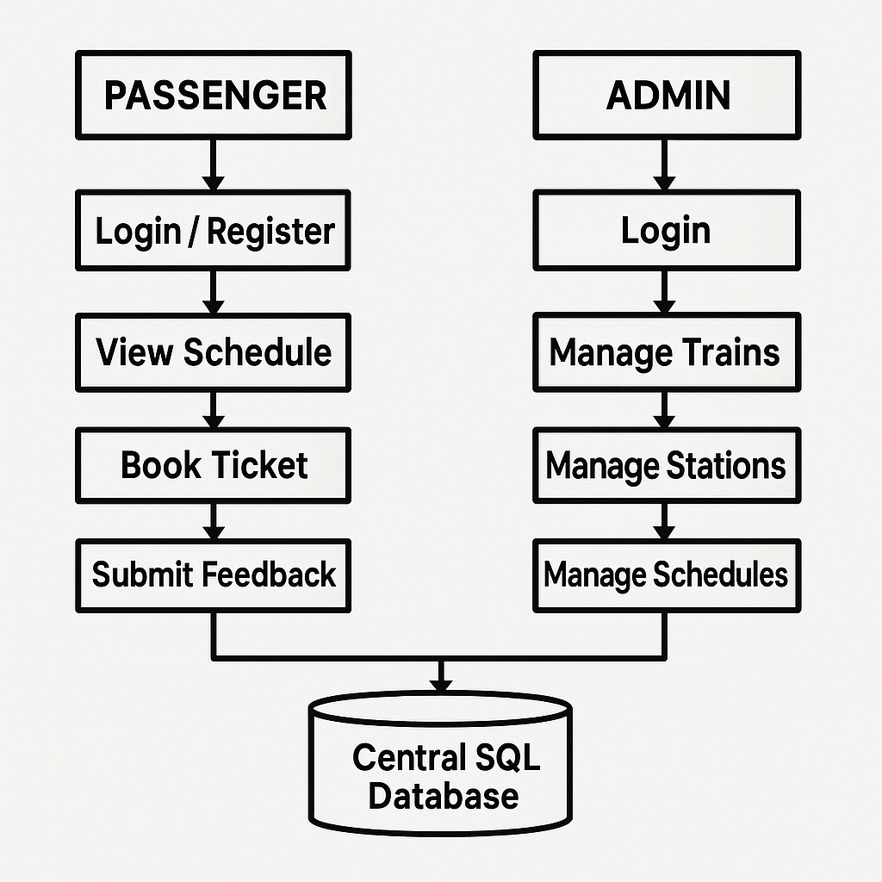
System Architecture
The flowchart shows how passengers and admins interact with the system through different modules, all connected to a central SQL database.
Admin Can handle Trains, Station, and manage Schedules while Passengers can view Schedules, book tickets and submit feedback

Slide 6
Modules Overview
1. Passenger Module ( Login/Register, View Schedules ,Book Trains)
2. Admin Module (Secure Login, Add/Edit/Delete Train and Schedules)
3. Train & Schedule Management ( Admin manages Trains, Station Routes and Timing )
4. Booking Module (Passengers book tickets linked to schedules and seat availability)
5. Feedback Module (Passengers can submit suggestions or complaints)
6. Authentication Module(Ensures secure login for both admin and passengers)
Each module is connected to the SQL Server database for real-time data storage and retrieval.

Slide 7
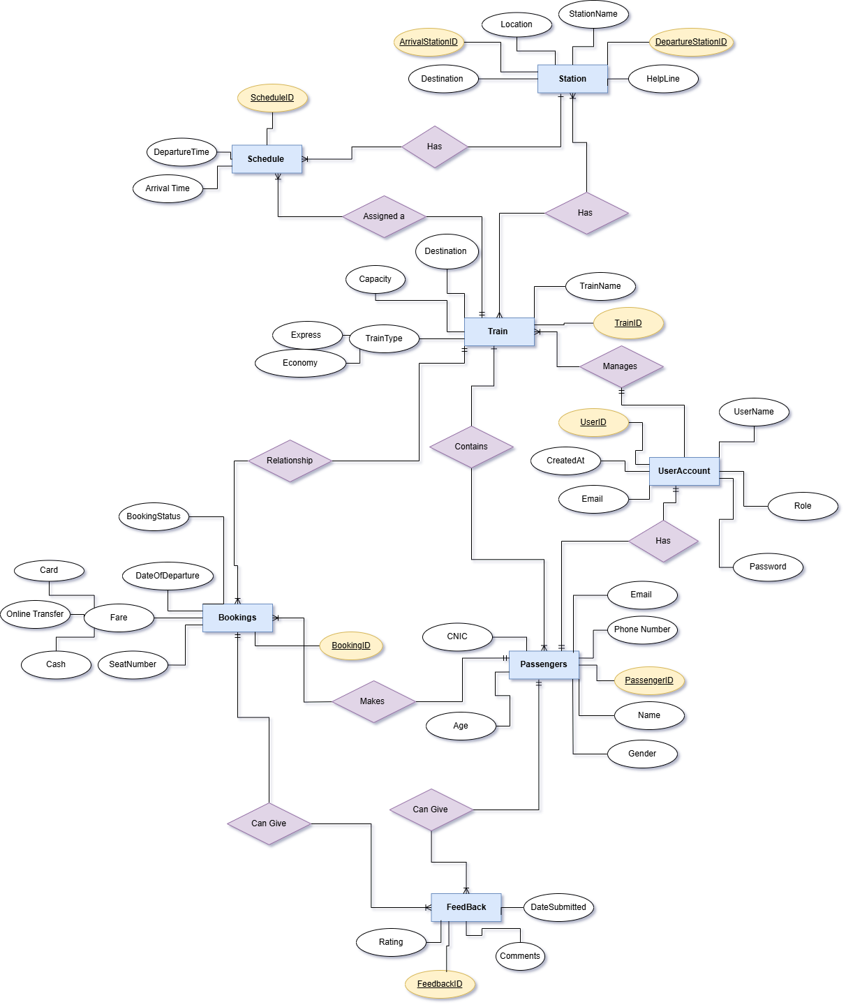
ER Diagram

Slide 8
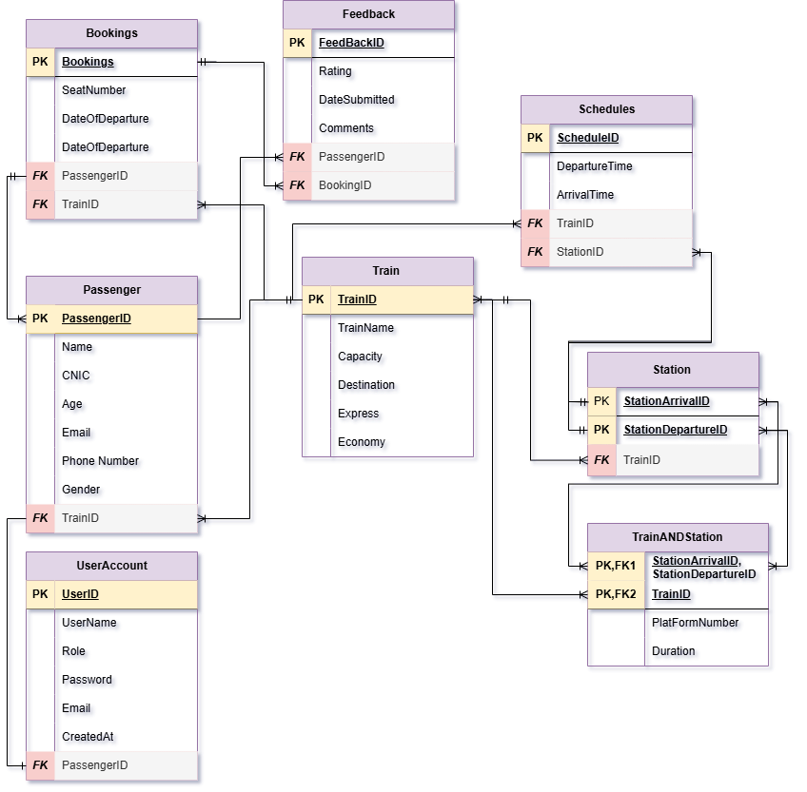
Relational Model

Slide 9
Technologies Used
This project uses a combination of front-end, back-end, and database technologies to ensure a smooth, reliable, and interactive system.
1. Front-End:
Windows Forms (C#) Used for building the graphical user interface for both passenger and admin panels.
2. Back-End:
C# Programming Language Handles form logic, event handling, database communication, and validations.
3. Tools:
Microsoft Visual Studio (for C# development)
SQL Server Management Studio (SSMS) for database management

Slide 10
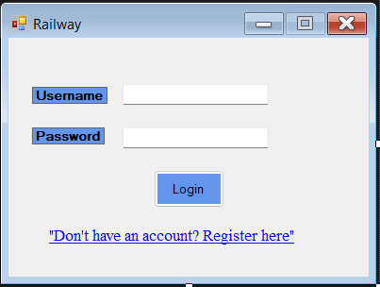
Login Interface
Login Screen:
Shows the passenger or admin login form.
Admin or Passenger can login using their Credentials

Slide 11
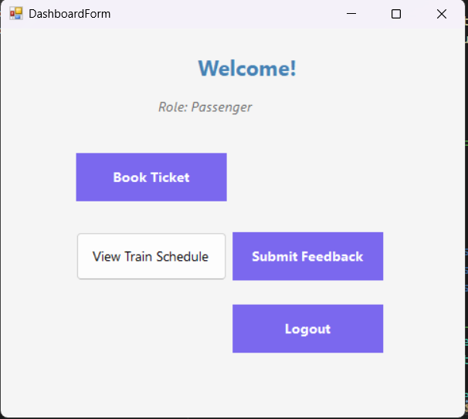
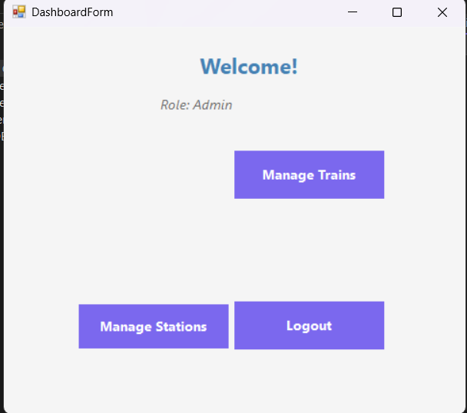
Dash Board Interface
The project features two separate dashboards: one for passengers to book tickets, view schedules, and give feedback; and one for admins to manage trains, stations, schedules, and review feedback. This separation ensures clear roles and secure access.
The Other GUI is for admins to manage trains, stations, schedules, and . This separation ensures clear roles and secure access.

Slide 12
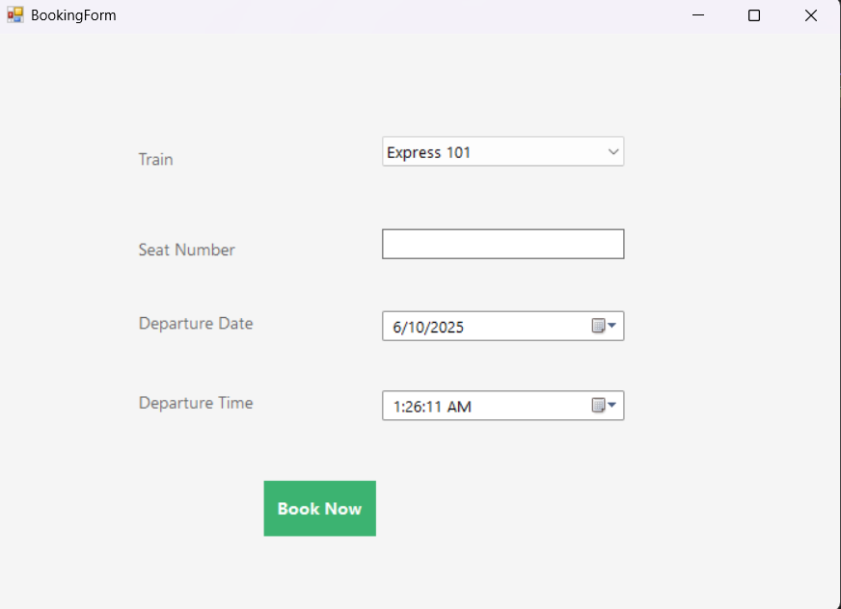
Booking Interface
The booking system allows passengers to select a train from the available schedule and book tickets by entering required details. Each booking is linked to a specific train and schedule, and the information is stored in the database for future reference and management.

Slide 13
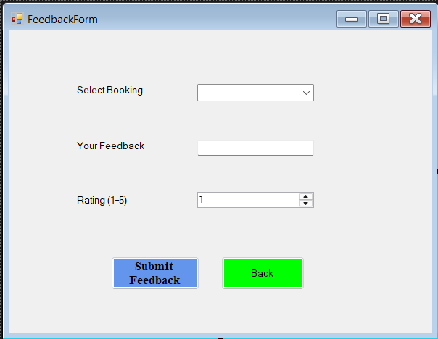
Feed Back Interface
The Passenger Feedback feature lets users rate their journey and submit comments linked to their bookings. This helps improve service quality by collecting direct input from passengers.

Slide 14
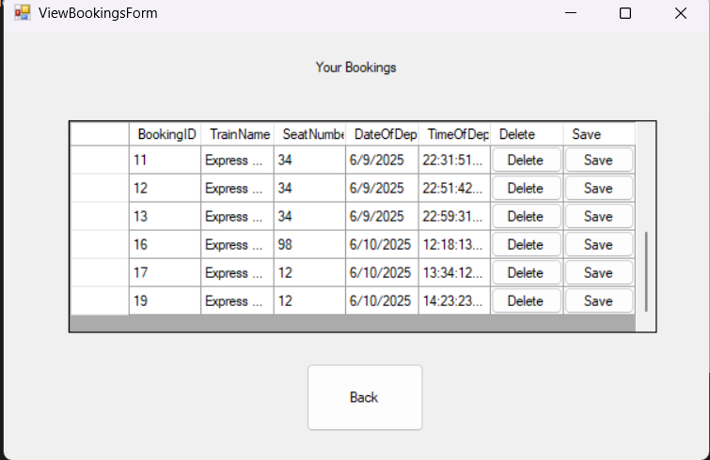
Bookings Details Interface
The View Booking interface displays a passenger’s current and past bookings, including train details, dates, and seat information. It allows users to review their travel history and verify booking status.

Slide 15
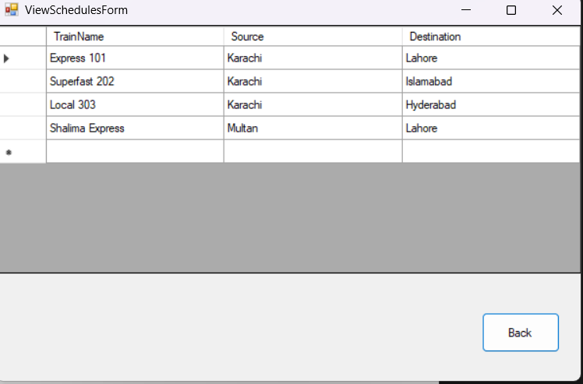
Train Schedules Interface
The View Train Schedules interface lets passengers check train routes, and stop details. It helps users plan their journeys by showing up-to-date schedule information.

Slide 16
Challenges Faced
Integrating the C# application with SQL Server for smooth data flow
Implementing separate access for admin and passenger roles
Managing data consistency for bookings and schedules
Debugging and testing to ensure error-free functionality

Slide 17
Conclusion
The Railway Reservation System successfully streamlines ticket booking and schedule management through a user-friendly interface and secure database operations.
It reduces manual effort, improves accuracy, and provides clear role separation between passengers and admins. The project also demonstrates effective integration of C# with SQL Server for real-time data handling.
This system lays the foundation for future enhancements like online payments, seat selection, and mobile app integration.

Slide 18
